Slide 1
“Engineering of perovskite photocatalysts for sunlight-driven hydrogen evolution from water splitting”, SunToChem
1.1.1.5/M-ERA-NET/19/02 project (2019-2022)

Slide 2
Project aim: new efficient materials for hydrogen production from water splitting
Partners: ISSP UL– theory and prediction of new efficient materials
Stefan Joz‘ef Institute, Ljubljana, Slovenia- synthesis of recommended perovskite nanoparticles
Taiwan University- experimental check of photocatalytic hydrogen production
All three partners are world experts in their field, expertise is complementary

Slide 3
Main results of the SunToChem (ERA-NET) project
As the promising catalyst, nanoparticles of SrTiO₃ doped with Al and other impurities was used.
Our (UL ISSP) theoretical modelling of surfaces and reactions on SrTiO3 stepped surfaces in faceted nanoparticles of different shapes and sizes as grown by Slovenian partners has predicted the largest advantage of Al doping which efficiently prevents electron- hole recombination and thus stimulates proton reduction with H₂ production.
The experimental verification of our prediction and relevant explanation done by Taiwan partners using new twin photoreactors has confirmed that Al doping greatly increses the efficiency of the hydrogen production under both untraviolet and sun light irradiation, and different methods of nanoparticle growth.
This allows us to achieve the goal of the project: to exceed 1% efficiency in the sut-to-hydrogen conversion. The join paper summarizing experimental and theoretical achievements is in preparation, along with 10 theoretical papers published on our side.

Slide 4
Main goal: Defect modelling of perovskite-based materials for the photocatalytic water splitting by first principles calculations
Partner 1: INSTITUTE OF SOLID STATE PHYSICS, RIGA, LATVIA
Eugene Kotomin, Leonid Rusevich, Guntars Zvejnieks,
Yuri Mastrikov, Veera Krasnenko, Maxim Sokolov, Robert Eglitis,
Mara Putnin,a

Slide 5
WP1. Multiscale computer modelling of MTiO3 photocatalysits
Task 1. First principles calculations of basic properties for perovskite nanoparticles
Task 2. Prediction of the adsorption energies of intermediate products and reactivity of different stepped (facet) surfaces

Slide 6
Band gap engineering of STO: dopant/defect optimisation
The problem: how defects/dopants could reduce the STO band gap from 3.2 eV down
to visible light, ca. 2.5 eV? What is a role of defect levels in a gap?
To answer this question, we studied a series of defects (impurities):
-- Oxygen vacancies: shallow donors,
-- Al³⁺ impurities (compensated by charged O vacancies)
Methods: large scale first principles calculations using the state of the art computer codes
and methods (hybrid functionals): optimisation of the atomic, electronic structure and
optical properties, calculation of vibrational properties → helps in defect identification

Slide 7
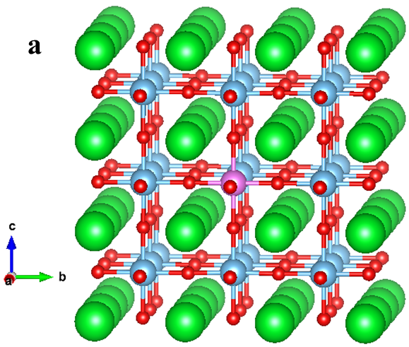
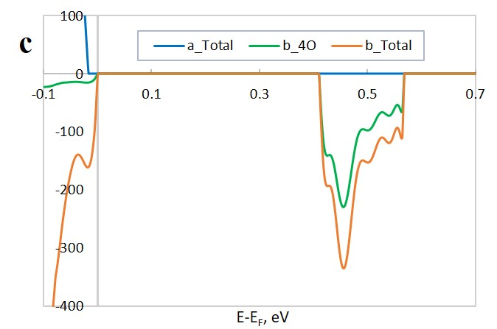
Modelling of Al impurities in bulk SrTiO₃:
atomic and electronic structure.
Effect of a hole trapping by Al impurity.
Formation of defect level:
hole trapping reduces e-h recombination and increases hydrogen production efficiency

Slide 8
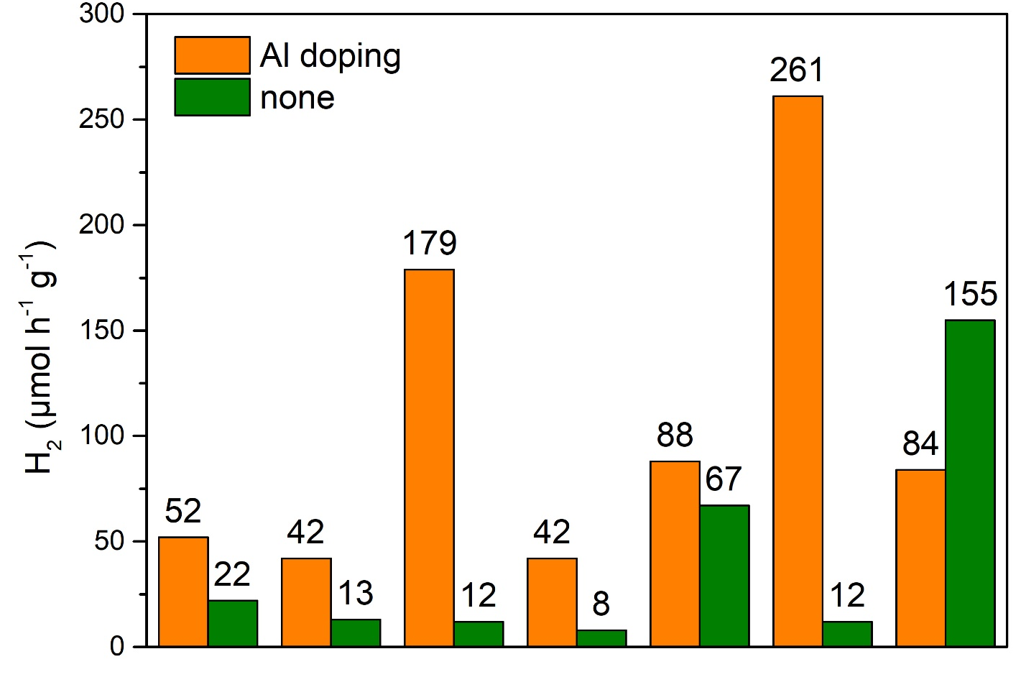
Experimental results of the Taiwan National University (Appl. Catal. B, 2023, 324, 122183)—confirmed theoretical prediction
Under UV lamp irradiation
Under Xenon lamp irradiation
NC900
SC900
KC900
NC1000
SC1000
KC1000
SC1150
NC900
SC900
KC900
NC1000
SC1000
KC1000
SC1150
Fig.1. The role of Al doping in increase of hydrogen production, NC900 etc are different conditions of
SrTiO3 nanoparticle growth.

Slide 9
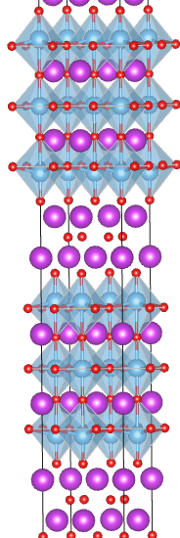
2. Key problems of STO/Bi₄Ti₃O₁₂ heterostructures:
--- Established the correct intermediate state of BiTO
(first theoretically, later confirmed experimentally)
--- Developed and verified comprehensive STO model
--- Accurate STO and BiTO description is mandataory for STO/BiTO band gap, charge separation estimates
Technical problems: accurate calculation of direct/indirect band gaps

Slide 10
3. A comparison of H2O adsorption and dissociation on STO flat (001) and faceted (stepped) surfaces:
--- molecular or dissociative adsorption
--- dissociation energy and kinetics (barrier);
--- proton formation and migration
4. Calculation of intermediates for oxygen co-production→ overpotential, to compare with Co3O4:
„Water interaction with perfect and fluorine-doped Co3O4 (100) surface” Solid State Ionics 277 (2015) 77–82: Yu.A. Mastrikov, E.A. Kotomin et al: Following Norskov and co-workers, the OER process consists of four elementary reaction steps, each involving the coupled transfer of an electron to the electrode and a proton to water (Sokolov et al, paper in progress)
5. Intermediate product detection: Raman spectroscopy

Slide 11
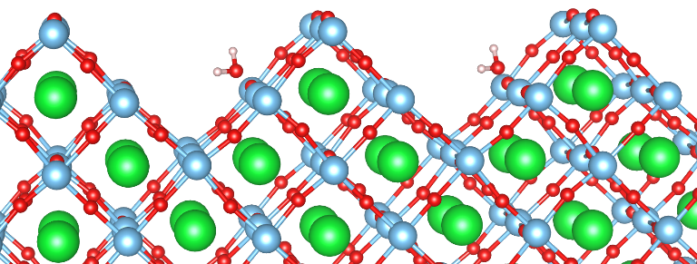
Faceted (stepped) surfaces: the best conditions for water dissociation
Proton migration (path, energy barriers)
Comparison with flat 001, 110 surfaces

Slide 12
Dissociation of water on STO stepped surface
H2O
dissociative
adsorption
On stepped
Surface

Slide 13
Raman spectra: identification of surfaces and products (OH radicals)
a

Slide 14
12 Publications (4 Open Access)
G.A. Kaptagay, N.A. Sandibaeva, T.M. Inerbaev, Yu.A. Mastrikov, E.A. Kotomin. Oxygen evolution reaction on a N-doped Co_{0.5}-terminated Co₃O₄ (001) surface.--Proc. Latv. Acad. Sci., Sect. B, 2020, 74, Nr 6, pp. 396-403.
D. Zablotsky, V. Kuzovkov, E. A. Kotomin. Role of Intrinsic Dipoles in the Evaporation‐Driven Assembly of Perovskite Nanocubes into Energy Harvesting Composites. Physica status solidi (a), 2020, 217, 1900533.
R.A. Evarestov, E.A. Kotomin, A. Senocrate, R.K. Kremer, J. Maier. First-principles comparative study of perfect and defective CsPbX3 (X = Br, I) crystals. Phys. Chem. Chem. Phys., 2020, 22, pp. 3914-3920.
E.A. Kotomin, Yu.A. Mastrikov, R. Merkle, J. Maier. First principles calculations of oxygen reduction reaction at fuel cell cathodes. Current Opinions in Electrochemistry, 2020, 19, pp. 122–128.
M. Sokolov, Yu.A. Mastrikov, G. Zvejnieks, D. Bocharov, E.A. Kotomin, V. Krasnenko. Water splitting on multifaceted SrTiO₃ nanocrystals: computational study.– MDPI Catalysts, 2021, 11, 1326 (pp. 1-8).
M.Ya. Rudysh, P.A. Shchepanskyi, A.O. Fedorchuk, M.G. Brik, V.Yo. Stadnyk, G.L. Myronchuk, E.A. Kotomin, M. Piasecki. Impact of anionic system modification on the desired properties for CuGa(S_{1-x}Se_{x})₂ solid solutions.-- Comput. Mater. Sci., 2021, 196, 110553 (pp. 1-10).
V. Serga, R. Burve, A. Krumina, M. Romanova, E.A. Kotomin, A.I. Popov. Extraction–pyrolytic method for TiO₂ polymorphs production.– MDPI Crystals, 2021, 11, 431 (pp. 1-13).
M. Tyunina, L.L. Rusevich, E.A. Kotomin, O. Pacherova, T. Kocourek, A. Dejneka. Epitaxial growth of perovskite oxide films facilitated by oxygen vacancies.-- J. Mater. Chem. C, 2021, 9, 1693-1700.
Y.-P. Lin, D. Bocharov, E.A. Kotomin, M.G. Brik, S. Piskunov. Influence of Au, Ag, and Cu adatoms on optical properties of TiO₂ (110) surface: predictions from RT-TDDFT calculations.– MDPI Crystals, 2022, 12, 452 (pp. 1-14).
V.Krasnenko, L.Rusevich, A.Platonenko, Yu.Mastrikov, M.Sokolov, E.Kotomin, Water splitting on multifacet SrTiO3 nanocrystals: calculations of Raman spectrum. Materials, 2022, 15, 4233 (pp. 1-17).(Open Access)

Slide 15
Joint publications (Open Access)
Y.-Y. Tai, J.C.S. Wu, W.-Y. Yu, M. Maček Kržmanc, E.A. Kotomin. Photocatalytic water splitting of improved strontium titanate for simultaneous separation of H2 in a twin photo-reactor. --- Appl. Catal. B, 2023, 324, 122183 (pp. 1-10).
L.L. Rusevich, E.A. Kotomin, G. Zvejnieks, M. Maček Kržmanc, J.C.S. Wu, Effects of Al doping on hydrogen production efficiency upon photostimulated water splitting on SrTiO₃ nanoparticles.--- J. Phys. Chem. C, 2022, 126, pp. 21223−21233.

Slide 16
Summary: All goals of the SunToChem project were fulfilled.
We predicted optimal nanomaterials (Al doped SrTiO3 nanoparticles) for photocatalytic hydrogen production, which was confirmed experimentally.
12 papers published, 5 are Open Access, 2 joint papers

Slide 17
Transferable two-dimensional correlated oxide layers (To2Dox)
Pārvietojamie divdimensionālie slāņi no pārejas metālu oksīdiem
ar elektronu korelāciju
FLAG-ERA JTC 2019 – To2DOx
(2020-2023)
Main partners:
Germany (Juelich research center)
Spain (Coordinator): University of Complutense
Latvia (LU CFI)

Slide 18
To2Dox projekta mērķis ir izgatavot un raksturot jaunu brīvi stāvošu divdimensionālo (2D) slāņu klasi,
kura pamatā ir pārejas metālu oksīdi ar elektronu korelāciju, un to kombinācijas daudzfunkcionālās
heterostruktūrās ar parastajiem 2D van der Waals (vdW) materiāliem.
Jaunā tipa brīvi stāvošie 2D oksīdu slāņi tiks sintezēti no epitaksiālajiem ultraplāniem oksīdu slāņiem,
kas audzēti, kontrolējot to sastāvu un struktūru atomu līmenī. 2D oksīda slāņi tiks pārvietoti un manipulēti,
izmantojot deterministiskās izvietošanas metodes, kas izstrādātas 2D vdW materiāliem.
Īpašas pūles tiks veltītas šo oksīdu slāņu unikālo virsmas rekonstrukciju un defektu struktūras
raksturošanai un to funkcionālajai reakcijai.
2D oksīda slāņu atomu, elektroniskās, magnētiskās un vibrācijas defektu īpašības tiks aprēķinātas
LU CFI teorētiskajā laboratorijā, izmantojot jaunākās teorijas metodes, kuru pamatā ir hibrīda funkcionāļi un superdatori.
To2Dox projektā realizē divu aktuālo virzienu kombinaciju: oksīdu saskarnes un 2D vdW materiāli.

Slide 19
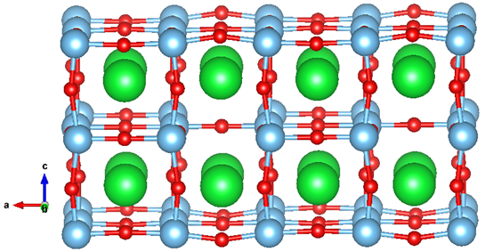
Brīvi stāvošas BaTiO₃ plātnes struktūras modelis ar vakancēm (sarkanie O atomi, zaļie Ti, zilie Ba).
Ultraplāno segnetoelektrisko (BaTiO3, SrTiO3) un feromagnētisko (LaSrMnO3) brīvstāvošo
slāņu atomārā un elektroniskā struktūra tika modelēta no pirmajiem principiem,
rezultāti nosūtīti partneriem eksperimentālai pārbaudei.

Slide 20
Veikti teorētiskie aprēķini “no pirmajiem principiem” N atomu piemaisijumu un skābekļa vakanču atomārās, elektroniskās un magnētiskās struktūras īpašības ultraplānajās SrTiO₃ kārtiņās dažādās pozīcijās.
a
b
The electronic DOS for slabs with substitutional N atom. (a) N in the central layer of the slab; (b) N on the surface of the slab. α_Total, β_Total—total DOS for alpha- and beta-electrons, α_N, β_N— DOS projected onto N atom (alpha- and beta-electrons); the zero value of the energy corresponds to the Fermi level.
N impurity location (inside the slab or on the surface of slab) leads to different effects in the electronic structure.

Slide 21
Currently in collaboration with German partners (Julich Research Center) we perform joint theoretical-experimental study of the correlations between distribution of the vacancies and electrons near the surface of advanced oxide materials and the catalytic properties.

Slide 22
Publications
M. Sokolov, Yu.A. Mastrikov, G. Zvejnieks, D. Bocharov, E.A. Kotomin, V. Krasnenko.
Water splitting on multifaceted SrTiO₃ nanocrystals: computational study.
Catalysts, 2021, 11, 1326 (pp. 1-8). Open Access
M. Tyunina, L.L. Rusevich, E.A. Kotomin, O. Pacherova, T. Kocourek, A. Dejneka.
Epitaxial growth of perovskite oxide films facilitated by oxygen vacancies.
J. Mater. Chem. C, 2021, 9, pp. 1693-1700. Open Access
L.L. Rusevich, M. Tyunina, E.A. Kotomin, N. Nepomniashchaia, A. Dejneka.
The electronic properties of SrTiO_{3-δ} with oxygen vacancies or substitutions.
Sci. Rep., 2021, 11, 23341 (pp. 1-8). Open Access
Y.-P. Lin, D. Bocharov, E.A. Kotomin, M.G. Brik, S. Piskunov.
Influence of Au, Ag, and Cu adatoms on optical properties of TiO₂ (110) surface:
predictions from RT-TDDFT calculations.
Crystals, 2022, 12, 452 (pp. 1-14). Open Access
M. Sokolov, Yu.A. Mastrikov, G. Zvejnieks, D. Bocharov, V. Krasnenko, K.S. Exner, E.A. Kotomin.
First principles calculations of hydrogen evolution reaction and proton migration on
stepped surfaces of SrTiO₃.
Adv. Theory Simul., 2023, 2200619 (pp. 1-7). Open Access

