Slide 1
The 2023 TWINNING call under Widening participation and spreading excellence
Kristin Kraav WIDERA NCP, Estonia

Slide 2
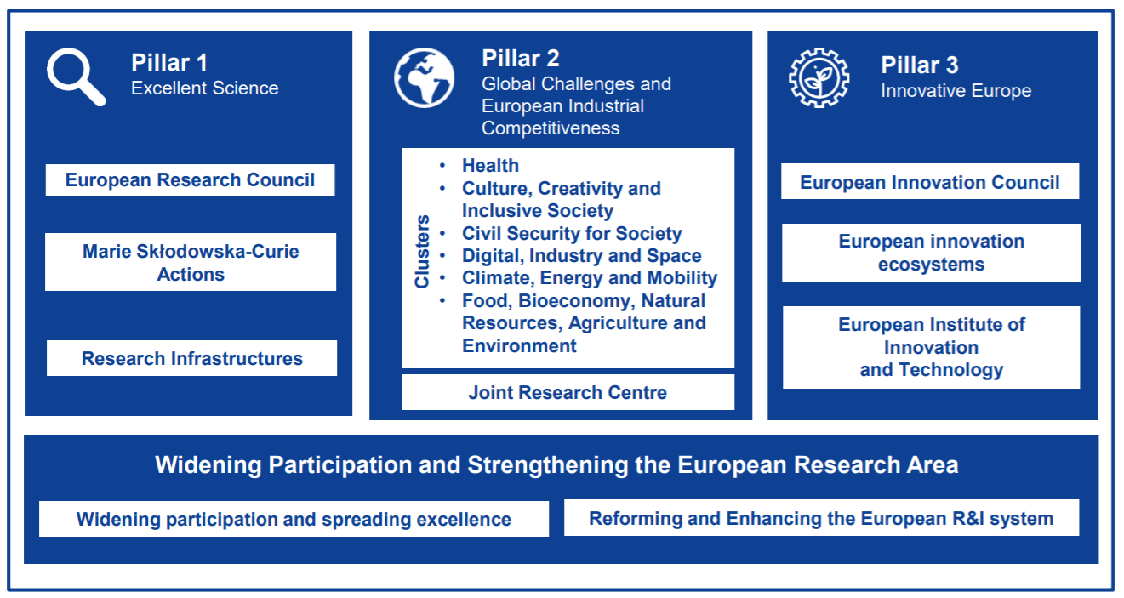
Horizon Europe

Slide 3
Widening instrumens 2023-2024
Teaming for Excellence, European Excellence Initiative – call deadline has passed
Twinning - Twinning aims to enhance networking activities between research institutions of the Widening countries, acting as co-ordinators, and top-class leading counterparts at European Union level, by linking it with at least two research institutions from two different Member States or Associated Countries.
Pathways to Synergies – The scheme will unlock synergies of Horizon projects with funds under the cohesion policy in Widening countries. It provides support for additional efforts required for setting up the interfaces between two different funding systems.
Dissemination and Exploitation Support Facility
Hop-on – It allows entities from low R&I performing countries to join already ongoing R&I actions. All consortium partners need to agree on the accession of the new widening partner and the accepted application will trigger an amendment to the ongoing action.
Excellence Hubs – This action focuses on innovation by allowing innovation ecosystems in Widening countries and beyond, by teaming up and creating better linkages between academia, business, government and society.
ERA Chairs – this action increases research capacity by attracting high-level researchers to a widening university or research centre. It will establish a research team fully integrated in the coordinator's institution to significantly improve its research performance in the scientific domain of choice.
ERA Talents – This action aims to boost interoperability of careers and employability of research and innovation talents across sectors, with a centre of gravity in widening countries.
ERA Fellowships – connected to MSCA Postdoctoral Fellowships

Slide 4
Twinning

Slide 7
Twinning
Bottom-up
Green Deal
Open to proposals from any research field
Focus on a defined area of research innovation directly linked to at least one of the actions listed in the European Green Deal strategy, notably transport, industry, energy, buildings’ ecological efficiency, nature and health protection, boosting global climate action

Slide 8
Twinning
Twinning aims to enhance networking activities between the research institutions of the Widening countries acting as coordinators and top class leading counterparts at European Union level by linking it with at least two research institutions from two different Member States or Associated Countries. Therefore, building on the potential of networking for excellence through knowledge transfer and exchange of best practice between research institutions and partners.

Slide 9
Twinning - scope
Twinning proposals should clearly outline the scientific strategy for stepping up and stimulating scientific excellence and innovation capacity in a defined area of research and innovation as well as the scientific quality of the partners involved in the twinning exercise This scientific strategy should include arrangements for formulating new (or ongoing) joint research innovation project(s) in the scientific area of choice and describe how Twinning will take this research to a new stage, by enlarging its scope and/or the research innovation partnerships.

Slide 10
Twinning consortium
Coordinator from a Widening country
Advanced partner 2
Advanced partners 3..4..5
Advanced partner 1

Slide 11
Twinning: possible activities
Capacity building activities:
Short-term staff exchanges;
Expert visits
Short term on-site or virtual training;
Workshops;
Organisation of joint summer school type activities;
Dissemination and outreach activities, incl. conference attendance
Dedicated work package or task: strengthening the research management and administration skills of the coordinating institution
Dedicated work package: research project not exceeding 30% of the budget

Slide 12
Twinning - Budget
Overall budget per project 0.8 – 1.5 million Euros
For the first time, Twinning call will use lump sum funding
Research component: max 30% of the total budget
50% of the research budget must remain with the coordinator

Slide 13
Additional information
WIDERA work programme 2023-2024
WIDERA calls in the Funding and Tenders portal
Widening infoday of the European Commission (2023-2024 work programme): video & presentation
Lump sum funding in Horizon Europe
WIDERA National Contact Points
WIDERA NCP project: https://www.ncpwideranet.eu/
Subscribe to our newsletter to be up to date
Funded Twinning projects on CORDIS website

