Slide 1
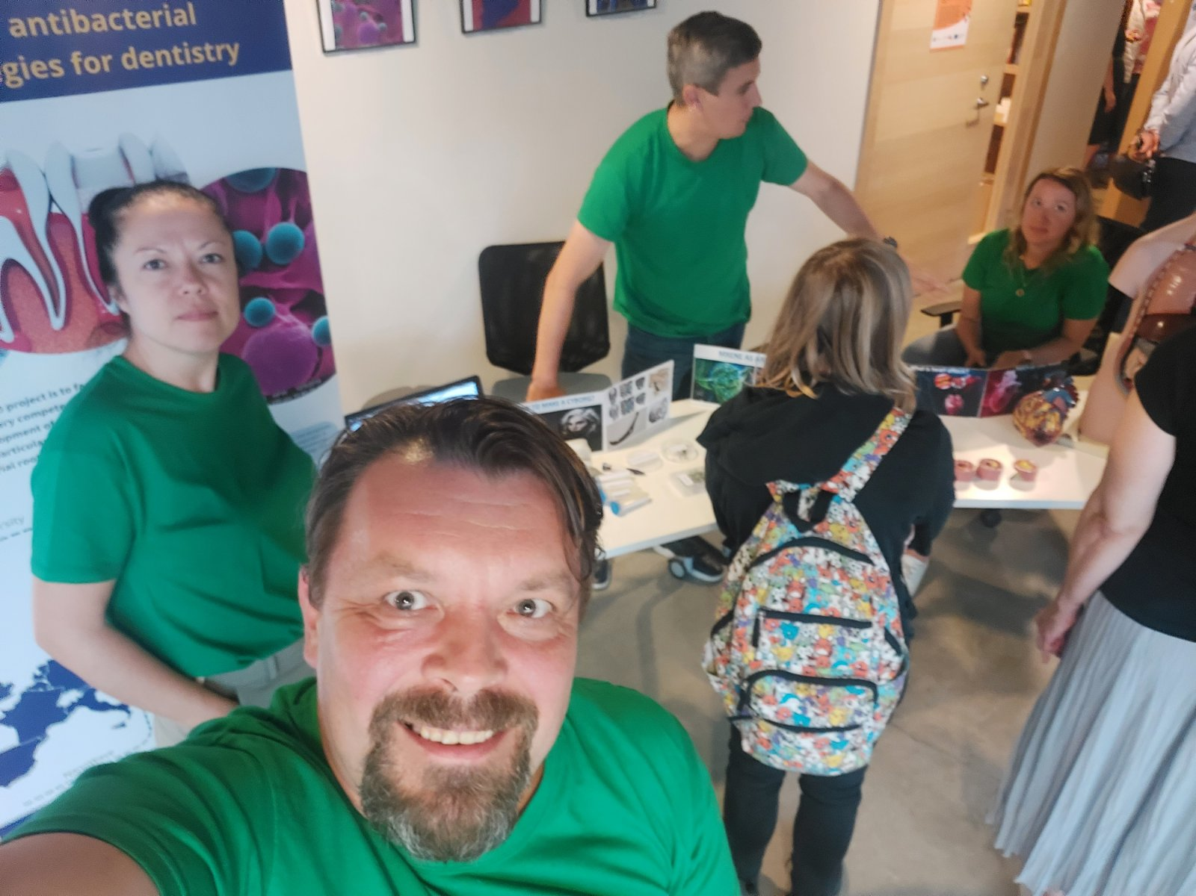
Success story of MSCA-SE project applications
HORIZON-MSCA-2022-SE-01
MSCA Staff Exchanges 2022
HORIZON-TMA-MSCA-SE
A-21563-ZR-N-109 - ESCULAPE 101131147
Viktoriia Korniienko
PhD, MD, Senior Visiting Researcher
Laboratory of optical biosensors and functional nanomaterials
Institute of Atomic Physics and Spectroscopy

Slide 2
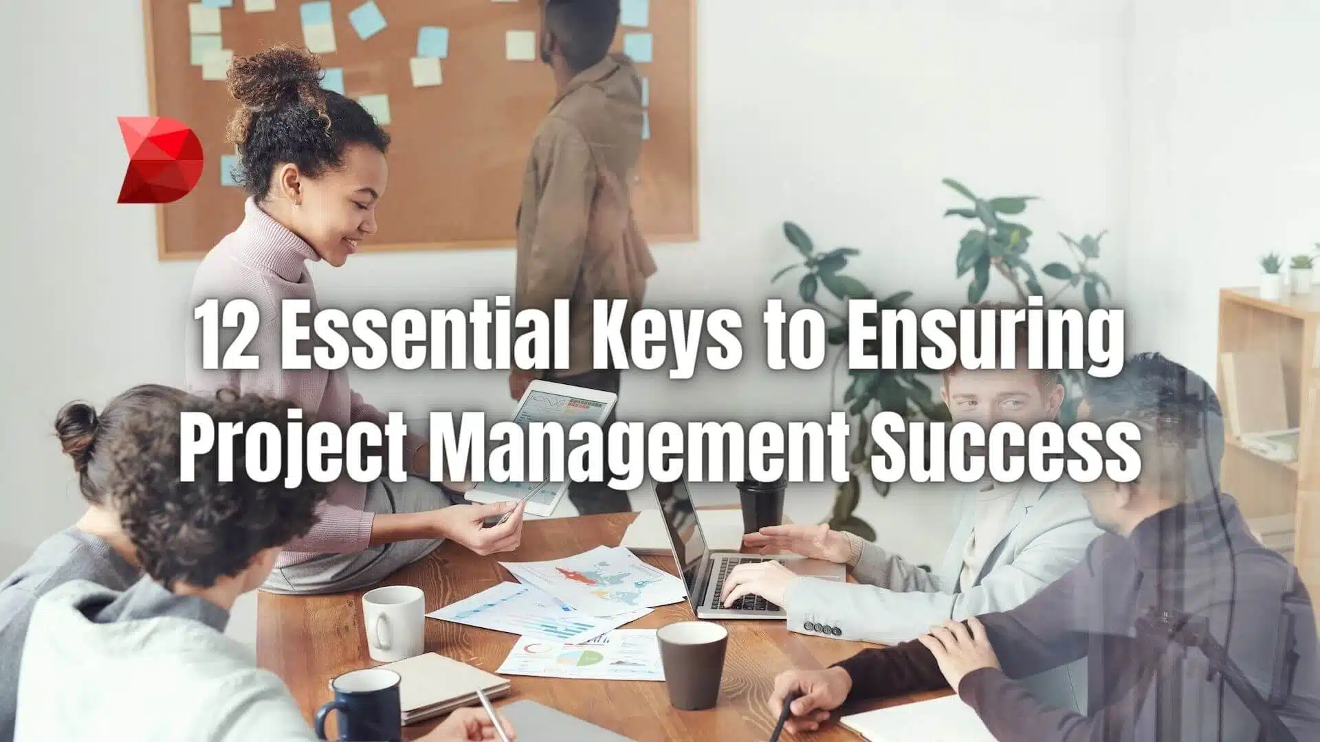
The keys for our successful projects
CHALLENGES and BENEFITS

Slide 3
What are the three keys to project success?
Scientific
team
Project research idea
Balanced consortium

Slide 4
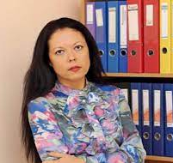
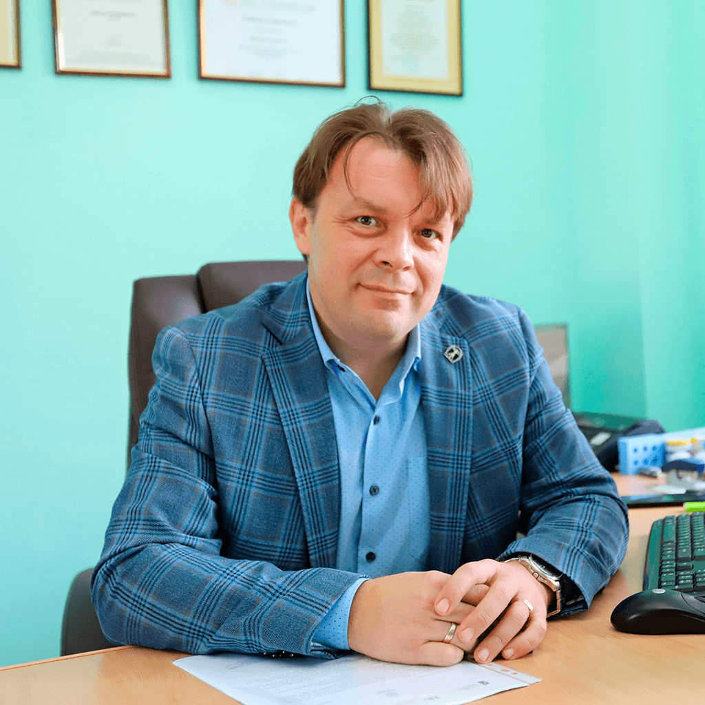
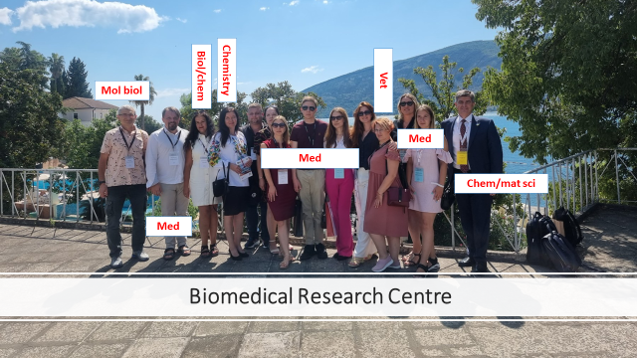
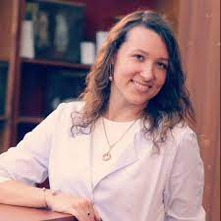
TEAM
Viktoriia Korniienko
Maksym Pogorielov
Volodymyr Deineka
Kateryna Diedkova

Slide 5
PARTNERS

Slide 6
How do we find and put partners together?
Partner in Erasmus KA 1 project
Partner of the partners
- Partner search tools
- Info days
- Conferences
ERAF 1.1.1.5/21/A/001
Partner from partner’s MSCA-SE
Partner from other MSCA-SE
Home university/best friend
Renata Schaeffer
University of Cambridge
Partners of existing partners
Existing partners

Slide 7
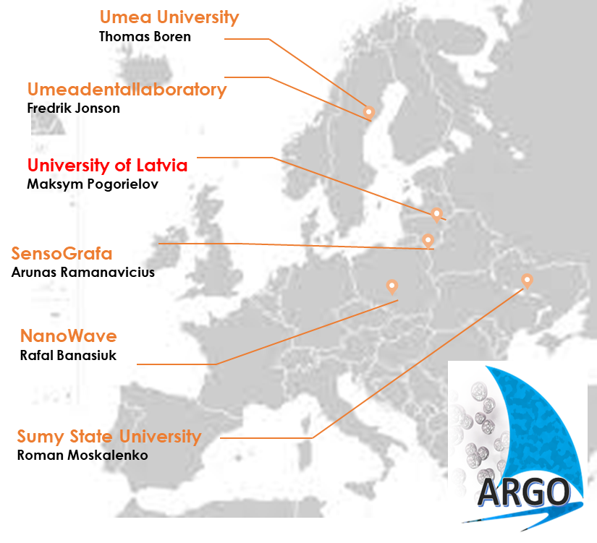
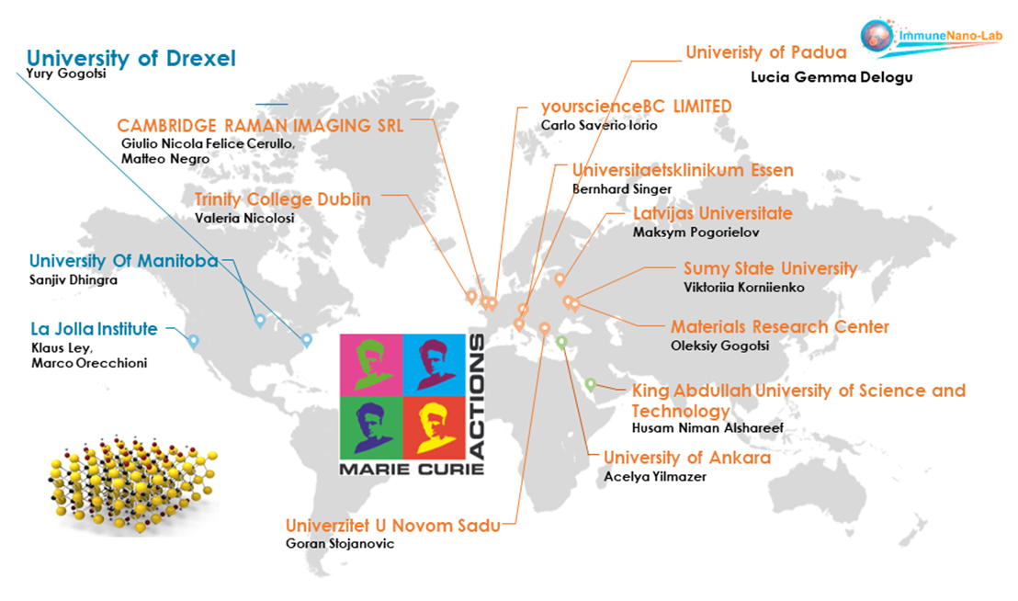
Our MSCA-SE-2022 projects
3 Academic partners
3 Industrial partners
7 Academic partners
3 Industrial partners
4 Associate partners
ARGO
MX-MAP

Slide 8
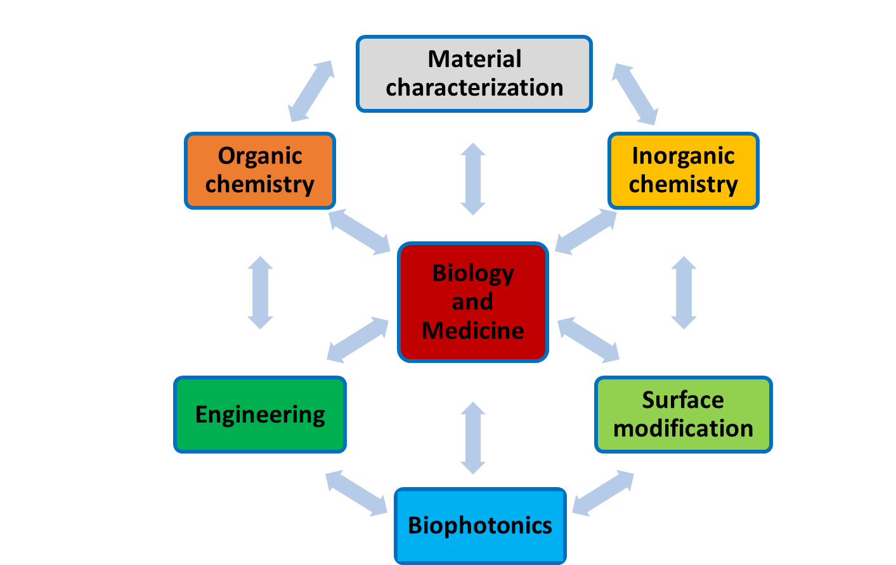
IDEA
ARGO
MX-MAP
Towards development of new antibacterial strategy for dentistry
Towards MXenes’ biomedical applications by high-dimensional immune MAPping
multidisciplinary
team
fruitful cooperation

Slide 9
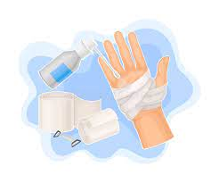
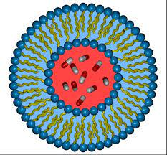
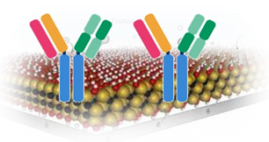
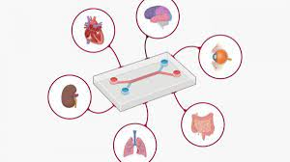
IDEA
NANO
materials
Tissue engineering
Antimicrobials
Biosensing
Theranostics
Photothermal therapy
Bioimaging
Drug delivery
BIOMEDICAL

Slide 10
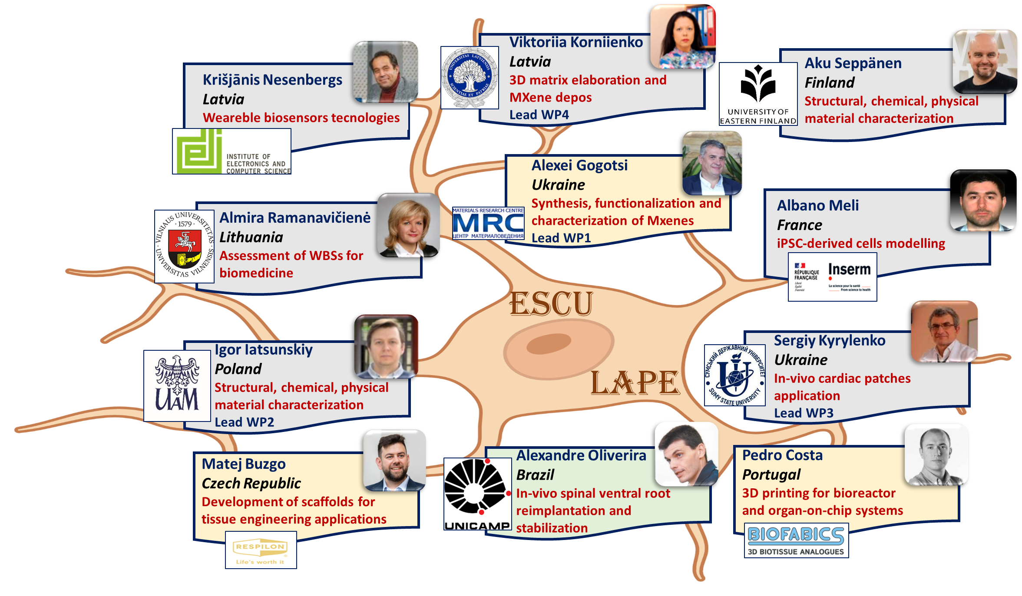
ESCULAPE
ELECTRO-CONDUCTIVE POLYMERIC 3D SCAFFOLDS AS NOVEL STRATEGIES FOR BIOMEDICAL APPLICATIONS
7 Academic partners
3 Industrial partners
1 Associate partners

Slide 11
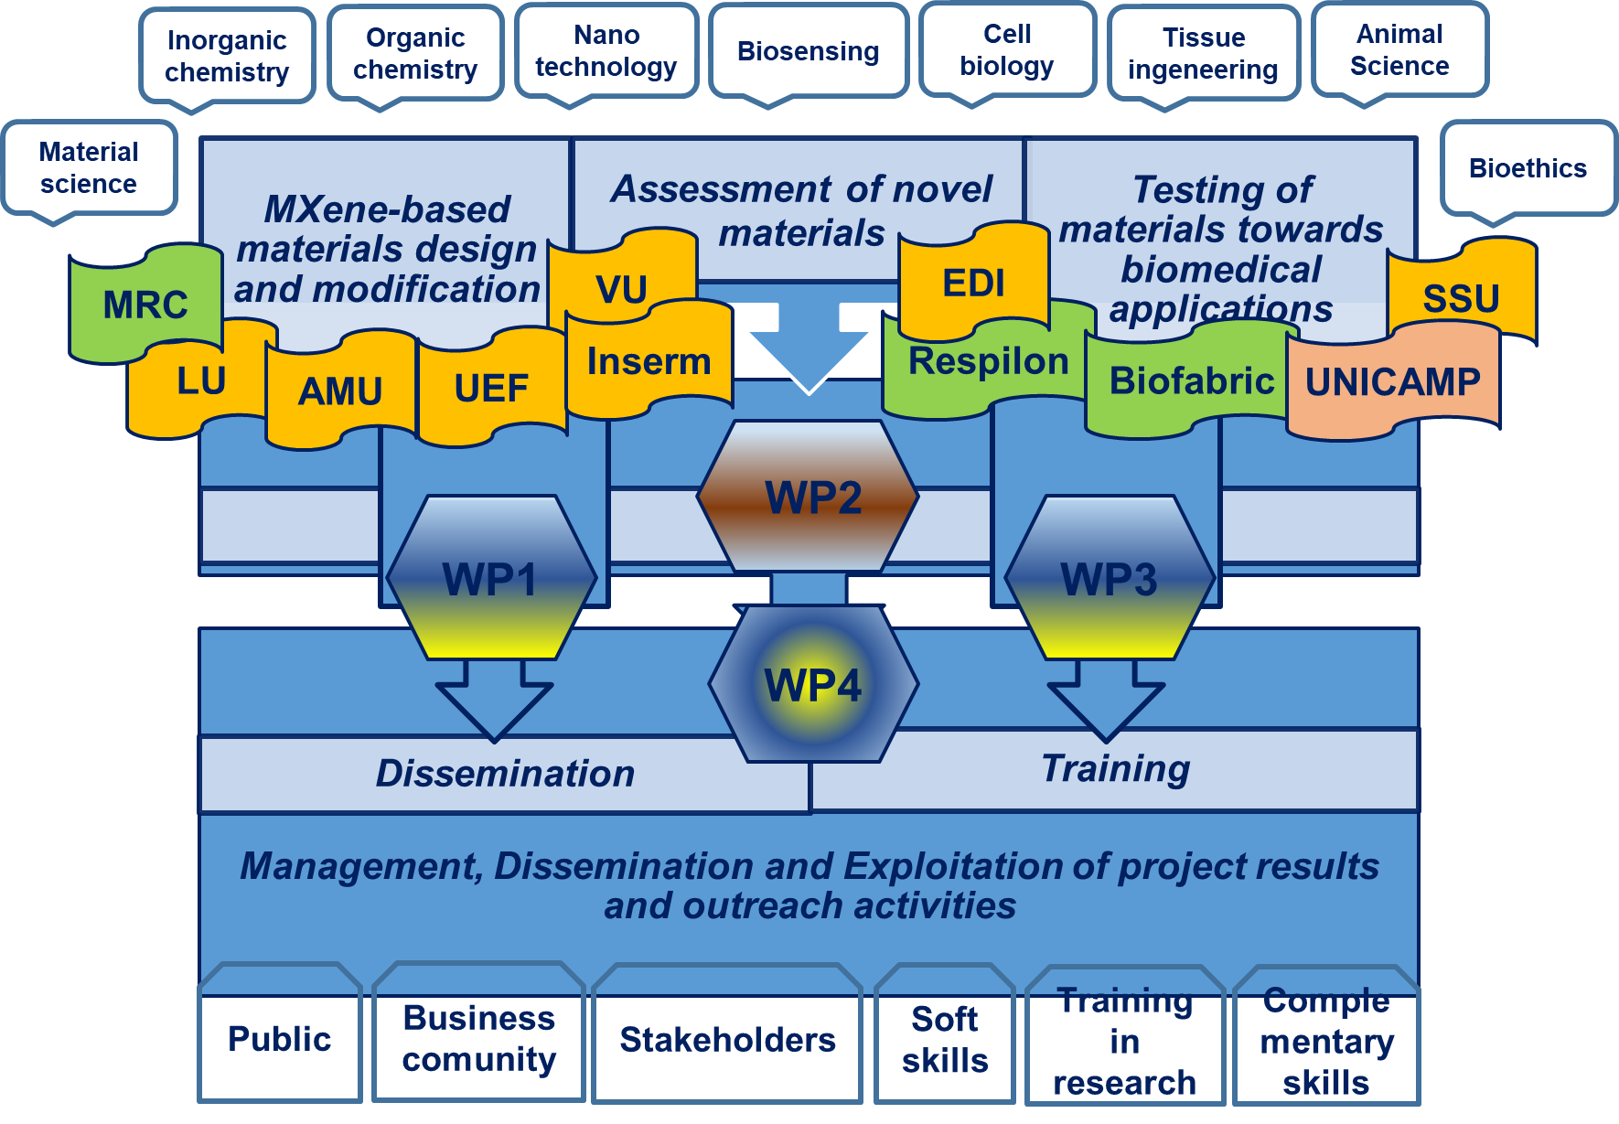

Slide 12
Small and medium-sized enterprises (SMEs)
Not clear direct impact
Access to
new market
No R&D* budget
Access to
new
technology
Lost of personnel during secondments
Access
to
research
facilities
CHALLENGES and BENEFITS
*direct expenditures relating to a company's efforts to develop, design, and enhance its products, services, technologies, or processes.

Slide 13
What are the three keys to project success?
Scientific
team
Project research idea
Balanced consortium
Balance in expertise
Balance in research
Balance in Academia/SME

Slide 14
Thank you for the attention!
Дякую за увагу!
Paldies par uzmanību!
Ačiū už dėmesį!
Tänan tähelepanu eest!
HORIZON-MSCA-2022-SE-01
MSCA Staff Exchanges 2022
HORIZON-TMA-MSCA-SE
A-21563-ZR-N-109 - ESCULAPE 101131147

