Slide 1
Marie Skłodowska-Curie Actions Staff Exchanges: how to broaden your Horizon? Webinar on MSCA SE 2023 call
October 10, 2023
10:00-12:30 EEST
Liene Kairiša
Marta Muter

Slide 2
Evaluation criteria (MSCA Work Porgramme 2023-2024, p. 100)
Excellence | Impact | Quality and efficiency of the implementation
Quality and pertinence of the project’s research/innovation objectives (and the extent to which they are ambitious, and go beyond the state of the art) | Developing new and lasting research collaborations, achieving transfer of knowledge between participating organisations and contributing to improving research and innovation potential at the European and global level | Quality and effectiveness of the work plan, assessment of risks, and appropriateness of the effort assigned to work packages
Soundness of the proposed methodology (including international, inter-sectoral and interdisciplinary approaches, consideration of the gender dimension and other diversity aspects if relevant for the research project, and the quality of open science practices) | Credibility of the measures to enhance the career perspectives of staff members and contribution to their skills development | Quality, capacity and role of each participant, including hosting arrangements and extent to which the consortium as a whole brings together the necessary expertise
Quality of the proposed interaction between the participating organisations in light of the research and innovation objectives. | Suitability and quality of the measures to maximise expected outcomes and impacts, as set out in the dissemination and exploitation plan, including communication activities
 | The magnitude and importance of the project’s contribution to the expected scientific, societal and economic impacts.
50% | 30% | 20%
Notes:
Ex-aequo Proposals •
When the total scores of two or more proposals are equal (ex-aequo cases), the priority order will be established as follows:
1) The proposals will be prioritised according to the scores they have been awarded for the criterion ‘Excellence’. When these scores are equal, priority will be based on scores for the criterion ‘Impact’.
2) If a distinction still cannot be made, the panel may decide to further prioritise by considering other factors such as gender and other diversity aspects in the research activities, participation of the non-academic sector (including involvement of SMEs), geographical diversity109, international cooperation, favourable working/secondment conditions or relationship to the Horizon Europe objectives in general. These factors will be documented in the panel report.

Slide 3
Excellence
Excellence
Objectives & state-of-the-art
Methodology
Quality of interaction
1.1. | Quality and pertinence of the project’s research/innovation objectives (and the extent to which they are ambitious, and go beyond the state of the art)
1.2. | Soundness of the proposed methodology (including international, inter-sectoral and interdisciplinary approaches, consideration of the gender dimension and other diversity aspects if relevant for the research project, and the quality of open science practices)
1.3. | Quality of the proposed interaction between the participating organisations in light of the research and innovation objectives.
50% of weight

Slide 4
1.1.Quality and pertinence of the project’s research/innovation objectives (and the extent to which they are ambitious, and go beyond the state of the art)
Introduction, objectives and overview of the research and innovation programme. Detail the research and innovation objectives.
Are the objectives measurable and verifiable?
Are they realistically achievable?
! Consider including your project's overarching goal - keeping in mind the objectives of the SE call.

Slide 5
Introduction
Explain your research
What is the context?
What is the subject?
Importance
How it address important EU/global challenges or priorities?

Slide 6
SMART approach
Specific Who? What? When? Where? Why?
Measurable – how you are going to know if the goal is accomplished?
Achievable - you have necessary knowledge, resources, skills, time etc.
Relevant – aligned with needs, priorities, challenges
Time – bound - state when it will done
Research objectives
Keep in mind that research objectives should correspond to the Work Packages under section 3.1

Slide 7
Why You and your project?
Why do you need to work together on this research?
Explain why a collaborative approach is needed to solve the problem and briefly why your consortium is best placed to do so.
Refer openly to the innovative elements of this project (topic, consortium, synergies...)
Describe the importance of the intersectoral and interdisciplinary approach.
Sustainability of collaboration: describe the benefits of cooperation and how they can go beyond this project
Make sure to cite consortium members’ work and show the high-level of expertise within the consortium

Slide 8
Pertinence and innovative aspects of the research programme (in light of the current state of the art and existing programmes / networks).
Why your research is original, innovative and timely compared to the state-of-the-art in the research area?
Describe
how your project goes beyond the state-ofthe-art,
how the overall research programme will deliver scientific breakthroughs, and
the extent to which the proposed work is ambitious.
How research objective address gaps in state-of-the-art?

Slide 10
1.2. Soundness of the proposed methodology (including international, inter-sectoral and interdisciplinary approaches)
Describe and explain the overall methodology including the concepts, models and assumptions that underpin your work.
Explain how this will enable you to deliver your project’s objectives.
Refer to any important challenges you may have identified in the chosen methodology and how you intend to overcome them.
Integration of methods and disciplines
If an interdisciplinary approach is unnecessary in the context of the proposed work, provide justification
PLAN of all SECONDMENTS
(not required, highly recommended)

Slide 11
1.2. Soundness of the proposed methodology (including international, inter-sectoral and interdisciplinary approaches)
PLAN of all SECONDMENTS
(not required, highly recommended)
2023:
Removal of Table 2 – Interdisciplinary secondments between partners within EU MS/AC participants in the same sector
Explain the added value of:
interdisciplinary approach in terms of addressing your research objectives and
transfer of interdisciplinary knowledge during the reintegration phase of seconded staff.
Ask yourself why this consortium is the best team to address these research objectives from a cohesive, interdisciplinary, and intersectoral point of view.
Highlight the role of each consortium member in the research programme.
Secondments should mainly be inter-sectoral.
Same-sector secondments (that meet the interdisciplinary conditions) in EU Member States and Horizon Europe Associated Countries (MS/AC) are eligible for funding for up to 1/3 of the project total eligible person-months funded by the EU
Secondments are considered as interdisciplinary if the activities performed during the secondment integrate aspects (information, data, techniques, tools, perspectives, concepts or theories) from two or more different scientific disciplines:
expert evaluators will consider the descriptors available in part A (first level of MSCA keywords)

Slide 12
1.2. Soundness of the proposed methodology (gender dimension and other diversity aspects, if relevant for the research project)
Content of the planned research and innovation activities (not: gender balance in the teams in charge of carrying out the project)
Activities where human beings are involved as subjects or end-users
Guidance on methods of sex / gender analysis and the issues to be taken into account: Standard application form gives suggestions.
Use, develop and/or deploy artificial intelligence (AI) based systems and/or techniques
> demonstrate their technical robustness:
Technically robust (accurate and reproducible, inform on fails)
Socially robust (context and envirornment)
Reliable and function as intended (safeguarding the physical and mental integrity of humans)
Explanation of decision-making processes
(when significant impact on people’s lives)

Slide 13
1.2. Soundness of the proposed methodology (quality of open science practices)
Open science is an approach based on open cooperative work and systematic sharing of knowledge and tools as early and widely as possible in the process.
It should be integral part of the proposed methodology (if not > justification)
How the choice of practices and their implementation are adapted to the nature of your work? > increase the chances of the project delivering on its objectives
early and open sharing of research
(preregistration, registered
reports, pre-prints, crowd-sourcing…)
research output management
measures to ensure
reproducibility of research outputs
providing open access to research outputs (publications, data, software, models, algorithms, workflows…)
participation in open peer-review
involving all relevant knowledge actors (including citizens, civil society and end users) in the co-creation of R&I agendas and contents
~ citizen science
Notes:
Open science practices - integral part of the proposed Open Research Europe – publishing platform – how it works?

Slide 14
1.2. Soundness of the proposed methodology (quality of open science practices)
Research data management and management of other research outputs
If you plan to generate/collect data or other research outputs (except for publications) during the project
How the data will be managed in line with the FAIR principles: Findable, Accessible, Interoperable, Reusable (max. 1 page)
make it specific to your project
Data Management Plan
types and estimated size
findability and trusted repositories
accessibility
interoperatibility
reusability
curation and storage/preservation costs; person/team responsible for data management and quality assurance

Slide 15
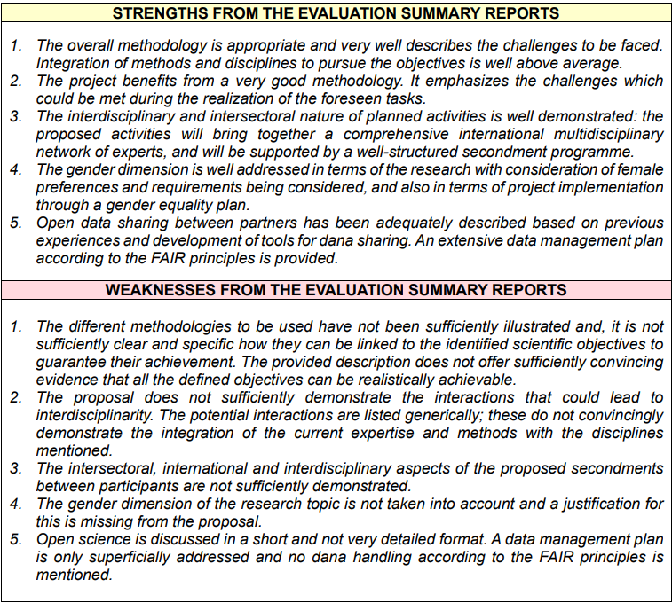
1.2. Soundness of the proposed methodology – comments by expert evaluators

Slide 16
1.3. Quality of the proposed interaction between the participating organisations in light of the research and innovation objectives.
Contribution of each participating organisation in the activities planned, with particular emphasis on the scientific objectives described in section 1.1.
Justification of the main networking activities (e.g., workshops/trainings/conferences, etc.).

Slide 17
Contribution of each participating organisation in the activities planned, with particular emphasis on the scientific objectives described in section 1.1.
Clearly state what each participating organisation will contribute towards achieving the research and knowledge transfer objectives – you can use a table for brevity and clarity.
Include their expertise, their contribution to networking events, and their level of participation in the secondments.
There should be an explicit link between networking activities and specific objectives of the project.
Include details on how many secondments are planned for the project and how many person months in total.

Slide 18
Justification of the main networking activities (e.g., workshops/trainings/conferences, etc.).
Describe the networking activities that will be organised to share knowledge e.g., workshops, meetings, trainings, online networking and knowledge sharing. Highlight interdisciplinary and intersectoral aspects to the networking and training activities.
Justify how these will contribute to the knowledge-sharing objectives – explain why you have chosen these particular activities and how are they related to the research objectives.
It could be valuable to open up some events to the wider research community, e.g., a final conference or summer schools open to researchers who are not part of the network/consortium.
Use a diagram to show the flow of people around the consortium.

Slide 20
Take home messages
Excellence part is a half of your proposal success (50% of weight);
Make sure you have clear and specific research objectives, and they are directly connected to work packages;
Think very specifically what are the strengths and uniqueness of your proposed consortium. Get everyone involved in the project activates and plan networking activities carefully!

Slide 21
Thank you! If you need any help, feel free to contact us: Liene Kairiša liene.kairisa@lzp.gov.lv Marta Muter msca@nawa.gov.pl

