Slide 1
How to write good proposal?
Tips and tricks
Prof. Nikos Mihalopoulos
Research Director
National Observatory of Athens

Slide 2
THE STEPS
OMM
Preparation well in advance
Find the adequate partners (core)
Carefully reading of the call (version slightly different from pre call)
1

Slide 3
During Writing
OMM
Proposal is not only science (5/15 max)
Impact and Implementation
Stakeholders-Policy
2

Slide 4
Opportunities
OMM
Networking (e.g European Infrastructures)
Hop on calls:
The Hop On Facility integrates one additional participant from a Widening country to an ongoing project under Pillar 2 or the EIC Pathfinder scheme while topping up a relevant task or work package and the cost incurred by the additional participant. The call has 2 official deadlines:
• 28 September 2023
• 26 September 2024
More info about the call can be found at : https://ec.europa.eu/info/funding-tenders/opportunities/portal/screen/opportunities/topic-details/horizon-widera-2023-access-06-01 .
3

Slide 5
Opportunities
OMM
Indicative projects for previous calls
Response of the Earth System to overshoot, Climate neUtrality and negative Emissions (RESCUE)
https://ec.europa.eu/info/funding-tenders/opportunities/portal/screen/how-to-participate/org-details/999999999/project/101056939/program/43108390/details
GREENHOUSE GAS FLUXES AND EARTH SYSTEM FEEDBACKS (GreenFeedBack)
https://ec.europa.eu/info/funding-tenders/opportunities/portal/screen/how-to-participate/org-details/999999999/project/101056921/program/43108390/details
Aerospace Composites digitally sensorised from manufacturing to end-of-life (INFINITE)
https://ec.europa.eu/info/funding-tenders/opportunities/portal/screen/how-to-participate/org-details/999999999/project/101056884/program/43108390/details
Carbon Neutral Milk (CANMILK)
https://ec.europa.eu/info/funding-tenders/opportunities/portal/screen/how-to-participate/org-details/999999999/project/101069491/program/43108390/details
Assessing Climate Change Risk in EUrope (ACCREU)
https://ec.europa.eu/info/funding-tenders/opportunities/portal/screen/how-to-participate/org-details/999999999/project/101081358/program/43108390/details
Attributing and Verifying European and National Greenhouse gas and Aerosol Emissions and Reconciliation with Statistical Bottom up estimates (AVENGERS ) https://ec.europa.eu/info/funding-tenders/opportunities/portal/screen/how-to-participate/org-details/999999999/project/101081322/program/43108390/details ICOS-ERIC is part of this project
4

Slide 6
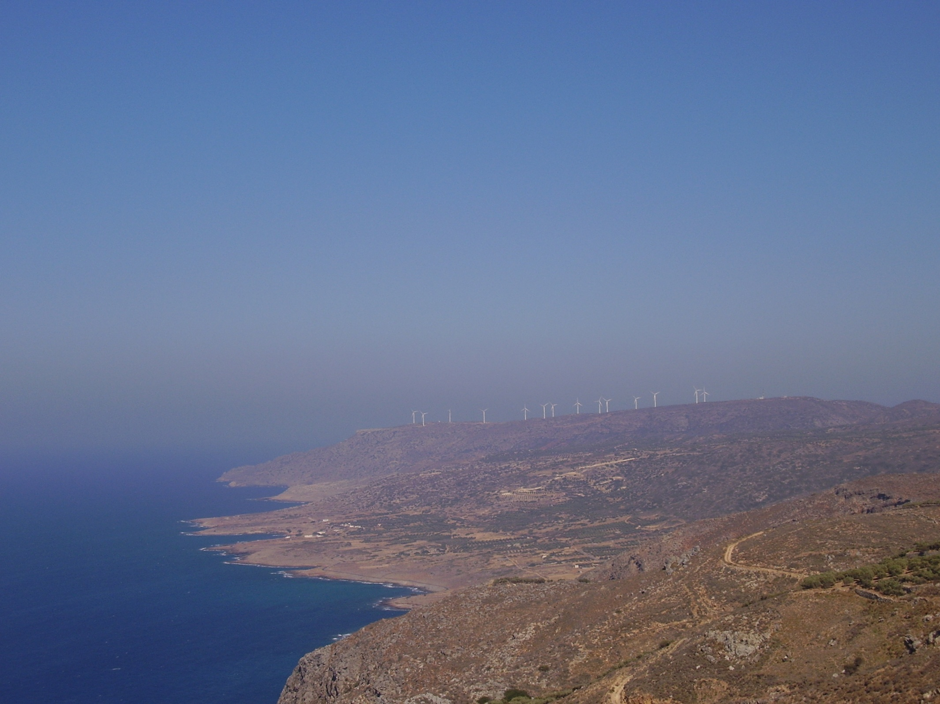
Thnak you for your Attention

