Slide 1
Marijas Skolodvskas Kirī aktivitātes - vispārēji
Liene Kairiša
Latvijas Zinātnes padomes
Starptautiskās sadarbības programmu projektu departamenta
Apvārsnis Eiropa Nacionālā kontaktpunkta vecākā eksperte
MSCA, ERC, Reforming and enhancing the European R&I system
E-pasts: liene.kairisa@lzp.gov.lv
Tel.: +371 29975961

Slide 2
«Nothing in life is to be feared, it is only to be understood. Now is the time to understand more, so that we may fear less.»
Marie Sklodowska Curie

Slide 3
Programmas raksturojums
Bottom – up
« 3 i principle»
Excellence
Training
Mobility
Networking
Best practice in recruitment of researchers

Slide 4
Konkursu veidi
Excellent idea
Postdoctoral Fellowships
Staff
Exchange
Doctoral Networks
MSCA and Citizens
COFUND
12 – 24 or 24- 36 months outgoing mobility to implement fellowship
1 -12 months international, intersectoral, interdisciplinary exchange of staff (incoming/outgoing mobility)
Implementation of doctoral programme - standard, industrial or joint
Public outreach/ science communication
Co-funding post-doctoral or doctoral programmes

Slide 5
Konkursu kalendārs 2024-2025
CALL | 2024
 | Opening | Closing
MSCA COFUND | 03 Apr 2024 | 26 Sep 2024
MSCA PF | 10 Apr 2024 | 11 Sep 2024
MSCA DN | 29 May 2024 | 27 Nov 2024
MSCA SE | 19 Sep 2024 | 05 Feb 2025
CALL | 2025
MSCA SE | 27 Mar 2025 | 08 Oct 2025
MSCA PF | 09 Apr 2025 | 10 Sep 2025
MSCA DN | 28 May 2025 | 25 Nov 2025
MSCA COFUND | 23 Jan 2025 | 24 Jun 2025
MSCA and Citizens | 17 Jun 2025 | 22 Oct 2025

Slide 6
Finansēšanas modeļi MSCA konkursos
Unit contribution
Doctoral Networks
Staff Exchange
Lump Sum
MSCA and Citizens
Postdoctoral Fellowships
COFUND

Slide 7
MSCA ir piemērots Jums, ja Jūs vēlaties
Īstenot savu ideju (bottom-up);
Īstenot projektu programmā, kurai ir prestižs
Saņemt 100% ES finansējumu (izņemot co-funding);
Iegūt ES projektu pieredzi;
Būt daļai no starptautiskas tīklošanās;
Veicināt savas karjeras izaugsmes iespējas;
Veikt vienu no vieglākajiem pieteikšanās procesiem AE

Slide 8
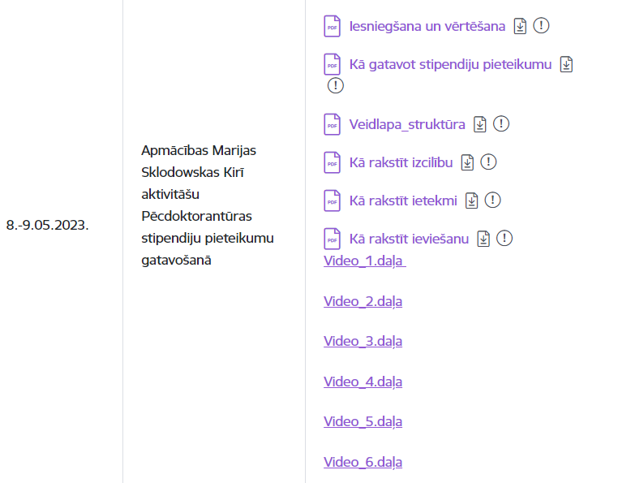
https://www.lzp.gov.lv/lv/pasakumu-informativie-materiali

Slide 9
Paldies!
https://www.facebook.com/HEncplv
https://twitter.com/apvarsnis
https://www.linkedin.com/company/nkplv/
Ceturkšņa ziņu lapa: https://dashboard.mailerlite.com/forms/207183/74477484042618291/share
9

